Slide 1
Topics will Be Covered:
Electric Charge
Voltage and Voltmeter
Current and Ammeter
Resistance
Resistance: Circular Wires
Temperature Effects on Resistance
Types of Resistors
Ohmmeter
Conductance
Ohm’s Law
Power
1

Slide 2
Chapter 2
Charge, Voltage and Current
2

Slide 3
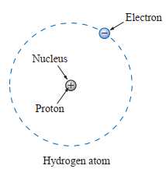
Electric Charge
Atomic Charge:
Two components of an electric charge [measured in Coulombs (C)] in an atom are:
Proton [+] Charge [Charge of an electron: + 1.602 × 10⁻¹⁹ C]
Electron [−] Charge [Charge of a proton: −1.602 × 10⁻¹⁹ C]
Normally atoms charge is neutral (there are an equal number of
number of protons and electrons in an atom).
When electrons are removed, positive charges are developed.
When electrons are attached, negative charges are developed.
Total deficiency or addition of excess electrons in an atom is called its charge and the element is said to be charged.
3

Slide 4

Important Characteristic of electric charge are:
The charge is bipolar, meaning that electrical effects are described in terms of positive and negative charges.
The electric charge exits in discrete quantities, which are integral multiple of the electronic charge, 1.602 × 10⁻¹⁹ C [Charge is measured in Coulombs (C) and represent by Q or q]
Electric effects are attributes to:
(i) the separation of charge which is creates an electric force (electromotive force, voltage)
(ii) the charges in motion which is creates an electric fluid (current).
4

Slide 5
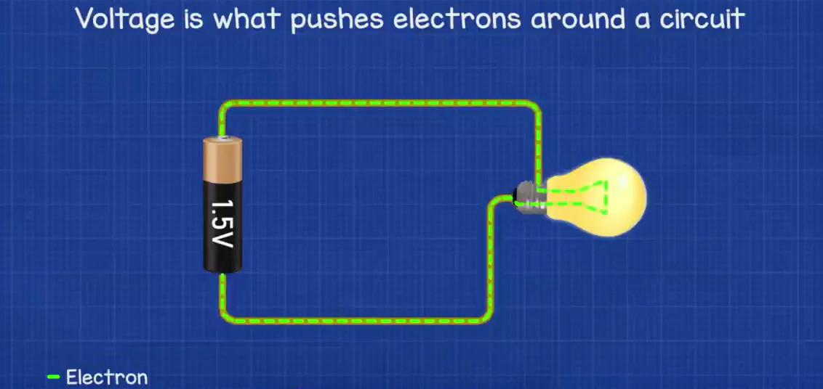
2.3 Voltage
Electromotive Force (emf): An electrical effort (some work or energy transfer) is required to move the free electron in one particular direction, in a conductor is called electromotive force (emf). This emf is also known as voltage or potential difference. EMF is created by chemical reaction (where positive charge and negative charge are separated) in battery or by changing magnetic field in a generator. It represents by “E”. Some time also use “V”.
Electric Potential: The ability of a charged particle to do work (when two similarly charged particles are brought near, they try to repel each other while dissimilar charges attracts each other) is called its electrical potential. Electric potential is also known as voltage. It also represents by “V”.
Potential Difference: The difference between the electric potentials at any two points in a circuit is known as potential difference. Potential difference is also called voltage or voltage drop between two points. It also represents by “V”.
Unit: The unit of emf or electric potential or voltage or potential difference is volt [V].
A potential difference of 1 volt (V) exists between two points if 1 joule (J) of energy is exchanged in moving 1 coulomb (C) of charge between the two points.
5

Slide 6






The potential difference between two points is determined by:
Example 2.3.1: Find the charge that requires 120 J of energy to be moved through a potential difference of 20 V.
According to Eq. (2.2), voltage is the energy (work done) needed to move a unit charge from one point to another point.
Solution: Given, W = 120 J, V = 20 V and Q = ?
Practice Book Problem [SECTION 2.3 Voltage] Problems: 7 to 10
6

Slide 7
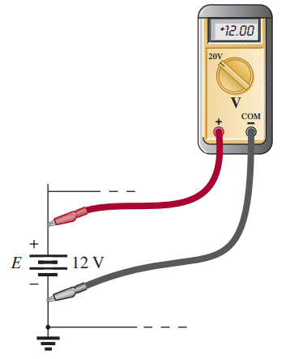
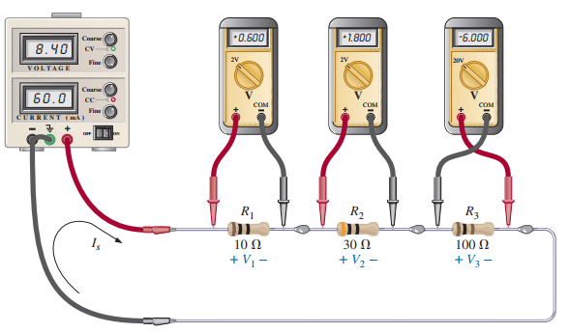
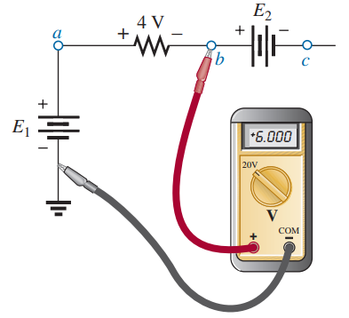
Voltmeter
Voltmeter measures the voltage.
Voltage always measure between two points.
Voltmeter is connected always in parallel.
7

Slide 8
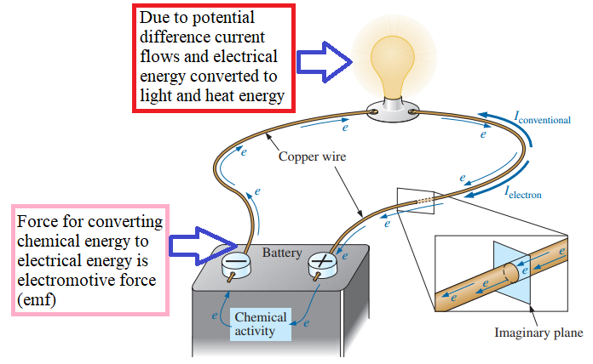




2.4 Current
The applied voltage (emf) is the starting mechanism —the current is a reaction to the applied voltage.
Definition: The rate of charge (Q) with respect to time (t) is known as the electric current.
Letter Symbol: It is represented by “ I ”. Unit is Ampere (A).
Relation Among Current, Charge and Time
1 Ampere: If 1 C [ or 6.24 × 10¹⁸ electrons] charge pass through a conductor in 1 second, the flow of charge, or current, is said to be 1 ampere (A).
8

Slide 9
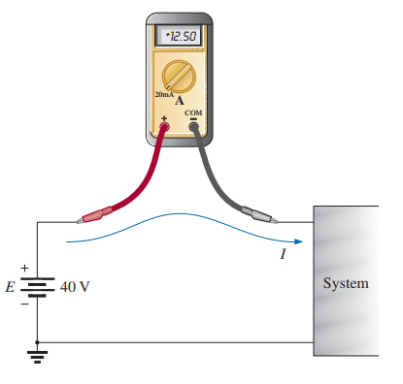
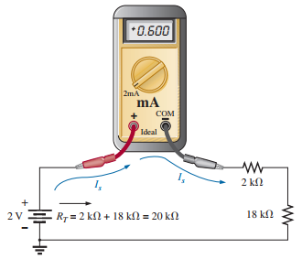
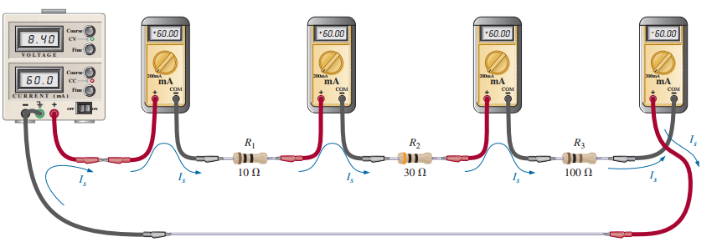
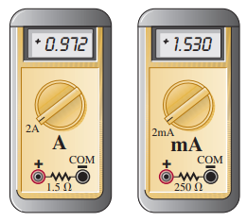
Ammeter
Ammeter measures the current in a circuit.
Ammeter is always connected in series.
9

Slide 10
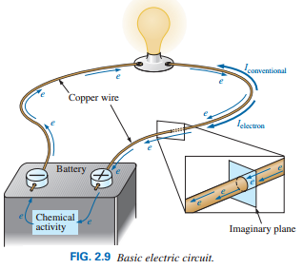


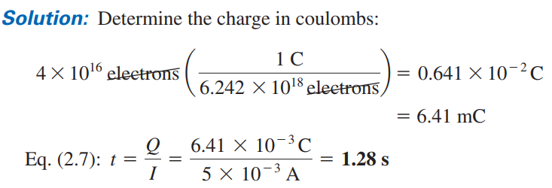
10

Slide 11

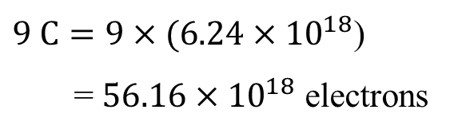
Q = It
Example 2.4.1: If a current 100 mA exists for 1.5 min, (i) how many coulomb of charge, and (ii) how many electrons have passed through the wire?
Example 2.4.2: If a conductor with a current of 120 mA passing through it converts 20 J of electrical energy into heat in 20 s, what is the potential drop across the conductor?
Solution: Given, I = 100 mA = 100 × 10⁻³ A, t = 1.5 min = 1.5 × 60 = 90 s
Solution: Given, I = 120 mA = 120 × 10⁻³ A,
W = 20 J, t = 20 s
(i) Q = I × t = (100 × 10⁻³) × 90
= 9000 × 10⁻³ C = 9 C
We know that, Q = It = (120 × 10⁻³ A) × 20 s
= 2.4 C
$\left(ii\right) We know that, 1 C= 6.24×{10}^{18}$ electrons
We know that,
$9 C=9×(6.24×{10}^{18}$)
= $56.16×{10}^{18}$ electrons
11

Slide 12
Q = It
Example 2.4.3: Charge is flowing through a conductor at the rate of 200 C/min. If 750 J of electrical energy are converted to heat in 45 s, what is the potential drop across the conductor?
Example 2.4.4: The potential difference between two points in an electric circuit is 48 V. If 1.2 J of energy were dissipated in a period of 15 ms, what would the current be between the two points?
Solution: Given, I = Q/t = 200 C/min = (200/60) C/s, W = 360 J, t = 45 s
Solution: Given, V = 24 V, W = 0.4 J, t = 15 ms = 15 × 10⁻³ s,
We know that, Q = It = (200/60 C/s) × 25 s
= 150 C
We know that,
We know that,
We know that,
Practice Book Problem [SECTION 2.4 Current] Problems: 11 – 17 and 21 – 23
12

Slide 13
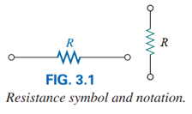
3.2 Resistance
The current in the electrical circuit not only depends on emf but also the circuit materials. Material in general have a property or ability to oppose/resist the flow of electric charge as well as current.
This opposition, due to the collisions between electrons and between electrons and other atoms in the material, which converts electrical energy into another form of energy such as heat.
Definition: The property of materials in an electrical circuit tending to prevent/resist the flow of current and at the same time causes electrical energy to be converted to heat is called resistance.
Letter Symbol: It is represented by “ R ”.
Unit is ohm (Ω).
1 ohm: The resistance of a material in an electrical circuit, in which a current 1 Ampere generates the heat at the rate of one Joules per Second is said to be 1 ohm.
13

Slide 14
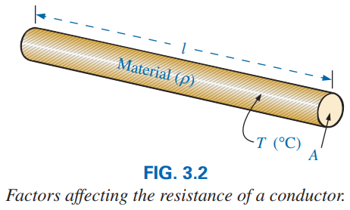
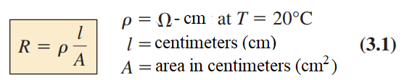
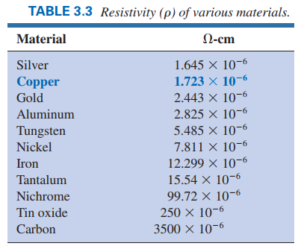
3.2 Resistance: Circular Wires
Equation of Resistance:
Factors Affecting the Resistance:
1. Length (l): Resistance is directly proportional to length.
2. Cross-sectional area (A): Resistance is inversely
proportional to area.
3. Material (ρ called rho): The material is identified by a factor
called the resistivity, which is measured in Ω−cm or Ω−m.
The higher the resistivity, the greater the resistance of a
conductor.
4. Temperature of the material (T): Generally, the resistance
increases as materials temperature increases. The effect of
small changes in temperature on the resistance is not
considered.
Resistivity: The resistance of a material having unit length (1 cm) and unit cross-sectional area (1 cm²) is known as its resistivity or specific resistance.
14

Slide 15


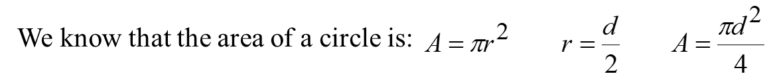


EXAMPLE 3.7 Determine the resistance of 100 ft of #28 copper (From Table 3.3, ρ = 1.723 × 10⁻⁶ Ω−cm) telephone wire if the diameter is 0.0126 in.
Solution: l = 100 ft, ρ = 1.723 × 10⁻⁶ Ω−cm, d = 0.0126 in.
Since l is given in feet (ft) and d is given in inch (in), first convert these quantities in cm.
We know that 1 ft = 12 in and 1 in = 2.54 cm
15

Slide 16
Example 3.2.1: Determine the value of resistance of an aluminum conductor if the area is increased by a factor of 3. The original resistance was 12 Ω.
Solution: Let in original case: length = l₁ cm, Area = A₁ cm², and resistivity = ρ₁ Ω-cm and R₁ = 4 Ω
When the area is increased by a factor of 3: length l₂ = l₁ cm, Area A₂ = 3A₁ cm², and resistivity ρ₂ = ρ₁ Ω-cm and R₂ = ?
Example 3.2.2: Determine the value of resistance of a silver conductor if the length is doubled. The original resistance was 5 Ω.
Solution: Let in original case: length = l₁ cm, Area = A₁ cm², and resistivity = ρ₁ Ω-cm and R₁ = 6 Ω
When the length is doubled : length l₂ = 2l₁ cm, Area A₂ = A₁ cm², and resistivity ρ₂ = ρ₁ Ω-cm and R₂ = ?
Practice Book Problem [SECTION 3.2 Resistance] Problems: 4, 7, 12 and 13
16

Slide 17
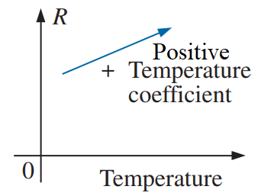
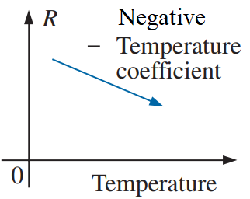
3.5 Temperature Effects on Resistance
Conductors
For good conductors, an increase in temperature results in an increase in the resistance level. Consequently, conductors have a positive temperature coefficient.
Semiconductors
For semiconductor materials, an increase in temperature results in a decrease in the resistance level. Consequently, semiconductors have negative temperature coefficients.
Insulators
Same as semiconductor materials, an increase in temperature results in a decrease in the resistance level of an insulator. Consequently, semiconductors have negative temperature coefficients.
17

Slide 18
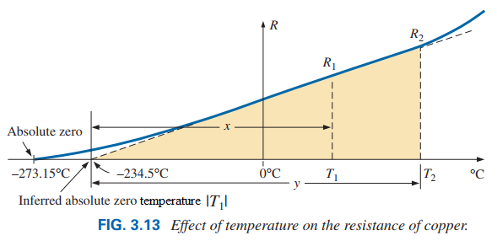
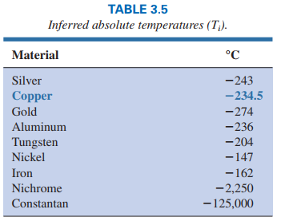
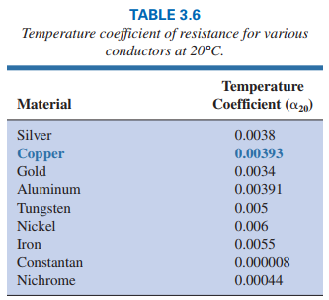


Relation of Resistances in Different Two Temperature
(3.9)
(3.10)
⏐T₁⏐ is called the inferred absolute temperature of the material.
α₁ is called the temperature coefficient of resistance at a temperature of T₁.
18

Slide 19
EXAMPLE 3.9 If the resistance of a copper wire is 50 Ω at 20°C, what is its resistance at 100°C (boiling point of water)?
Solution: Given, R₁ = 50 Ω, T₁ = 20°C, T₂ = 100°C, From Table 3.5, ⏐T₁⏐ = 234.5°C, R₂ = ?
EXAMPLE 3.10 If the resistance of a copper wire at freezing (0°C) is 30Ω , what is its resistance at −40°C?
Solution: Given, R₁ = 30 Ω, T₁ = 0°C, T₂ = − 40°C, From Table 3.5, ⏐T₁⏐ = 234.5°C, R₂ = ?
Practice also EXAMPLE 3.11
Practice Book Problem [SECTION 3.5 Temperature Effects] Problems: 23 to 27 and 29
19

Slide 20
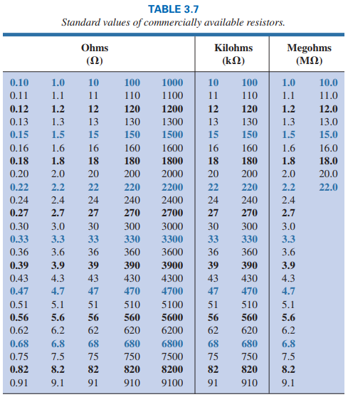
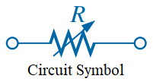
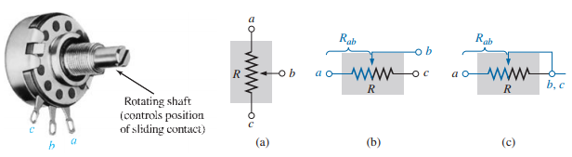
3.7 Types of Resistors
Fixed Resistors
Variable Resistors
Variable resistor is usually referred to as a rheostat or potentiometer.
20

Slide 21
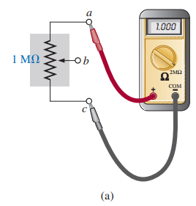
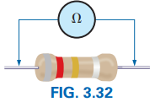
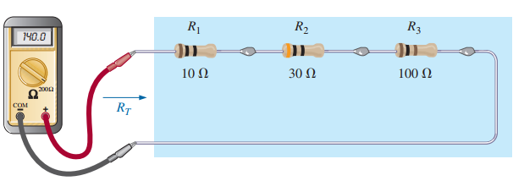
Ohmmeter
Ohmmeter measures the resistance in a circuit.
Ohm meter is connected in the two terminals of the resistance which ohm is needed to measure.
Ohmmeter is always connected in parallel.
In Figure (a) ohm meter is connected in between terminals a and b. So, it measured the total resistance (1 MΩ) in between terminals a and b.
21

Slide 22
3.9 Conductance
22

Slide 23
3.9 Conductance
Definition: The reciprocal of resistance is called conductance.
Conductance of a circuit indicates how well the material conducts electricity.
Letter Symbol: It is represented by “ G ”.
Unit is siemens (S).
Conductivity: (σ = 1/ρ): The reciprocal of resistivity is called conductivity.
23

Slide 24
EXAMPLE 3.9.1 Determine the conductance of 3048 cm length of copper telephone wire which resistivity is ρ = 1.723 × 10⁻⁶ Ω−cm and the area is 8.04 × 10⁻⁴ cm².
Solution: l = 3048 cm, ρ = 1.723 × 10⁻⁶ Ω−cm, A = 8.04 × 10⁻⁴ cm².
24

Slide 25
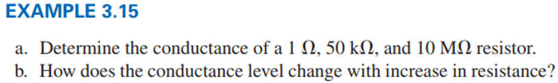
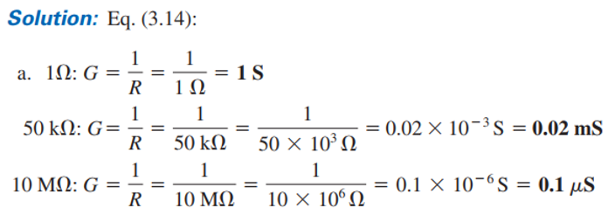
Practice Book Problem [SECTION 3.9 Conductance] Problem: 29
25

Slide 26
4.2 Ohm’s Law
26

Slide 27

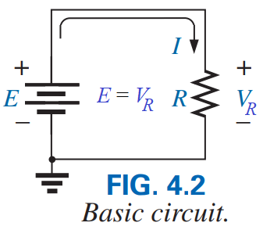
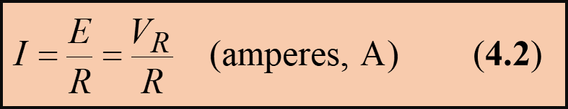
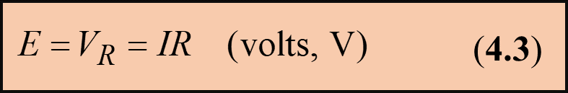
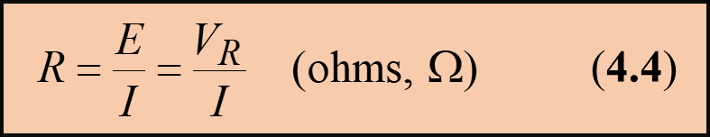
4.2 OHM’S LAW
Statement of Ohm’s Law: At fixed temperature, the current (I) flowing through a particular conductor is proportional to the potential or voltage difference (V) between the two points or ends of the conductor.
According to Ohm’s Law:
According to Fig. 4.2 and Ohm’s Law:
The symbol E is applied to all sources of voltage.
The symbol V is applied to all voltage drops across components of the network.
The symbol V_{R} is applied to represent voltage drops across a resistor.
27

Slide 28

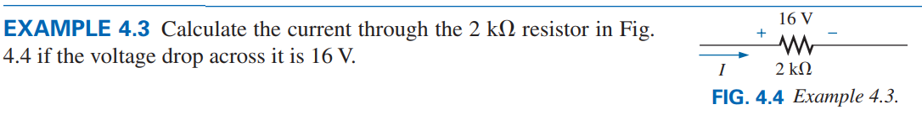

Practice Book Problem [SECTION 4.2 Ohm’s Law] Problems: 1 to 11 and 14
28

Slide 29
4.4 Power
29

Slide 30


4.4 POWER
Chapter 4
Definition: The rate at which work (expending or absorbing or conversion of energy) is done is called power.
Power indicates “how much work (energy conversion) can be accomplished in a specified amount of time”.
Letter Symbol: It is represented by “ P ”.
Unit is Watt (W).
According to Definition:
Relation among power, voltage and Current:
1 Watt (W) = 1 joule/second (J/s)
1 horsepower ≈ 746 watts
30

Slide 31
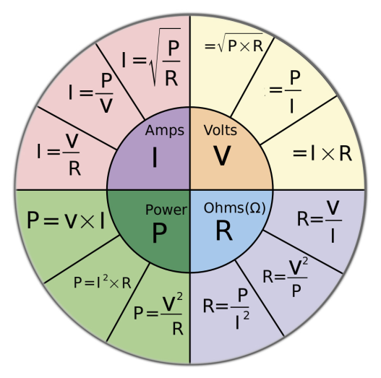
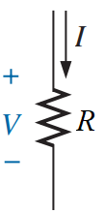
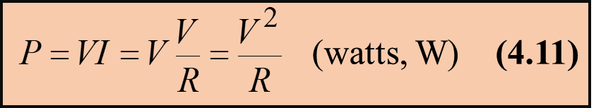
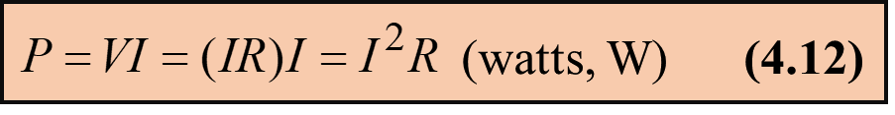
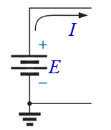
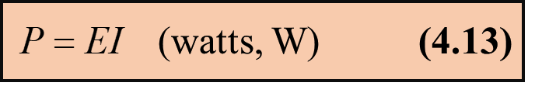
According to Eq. (4.10) we have:
For Load R:
For Source E:
31

Slide 32
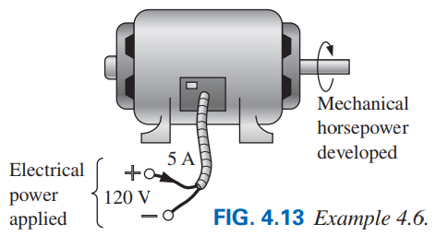

32

Slide 33
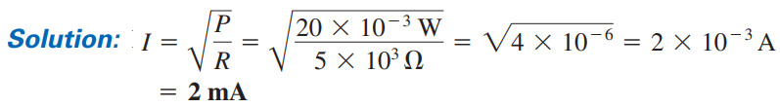
Exercise Problems
Solution: Given, W = 420 J, t = 4 min = (4×60) s =240 s and P = ?
Practice Book Problem [SECTION 4.4 Power] Problems: 21 to 37
33

Slide 34
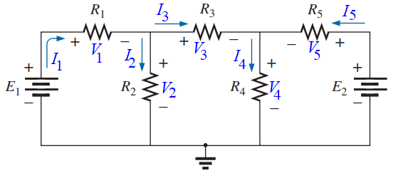
Tellegen’s Theorem [1952 by B. D. H. Tellegen] for Power
Statement:
(1) The sum of the powers absorbed by all elements in an electrical network is zero.
OR
(2) The power supplied in a network is exactly equal to the power absorbed.
According to Statement (1):
According to Statement (2):

